Slide 1




Slide 2

Case study/Situational Interview II

Slide 3
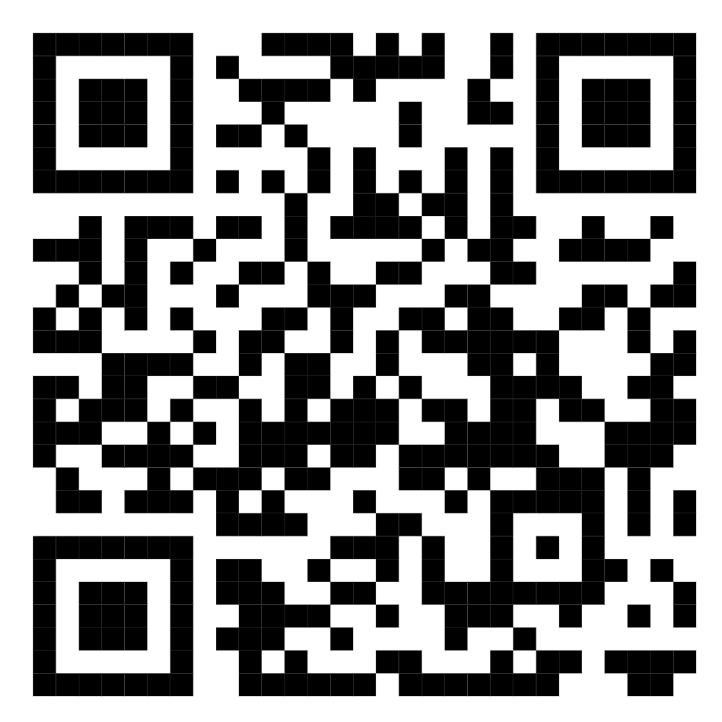
TEST TIME ON Case study/Situational Interview 1
QR CODE:

Slide 4

CONCEPTS
Structured and Unstructured Interview
Notes:
Structured interviews are those where an interviewer uses a predetermined list of questions to ask all job candidates. Having questions already laid out in advance can help hiring managers and HR professionals feel prepared as they head into an interview, and it can make the interview process more straightforward, mitigating bias both in the interview room and while evaluating applicants’ answers after the interview.
By contrast, unstructured interviews are more like free-flowing conversations that take different directions based on the candidate and their responses.
Both structured and unstructured interviews have their advantages and disadvantages during the hiring process; the right approach can depend on the type of position you’re hiring for and what skills you need to evaluate.

Slide 5

CONCEPTS
STRUCTURED INTERVIEWS VS. UNSTRUCTURED INTERVIEWS
Notes:
Structured interviews are those where an interviewer uses a predetermined list of questions to ask all job candidates. Having questions already laid out in advance can help hiring managers and HR professionals feel prepared as they head into an interview, and it can make the interview process more straightforward, mitigating bias both in the interview room and while evaluating applicants’ answers after the interview.
By contrast, unstructured interviews are more like free-flowing conversations that take different directions based on the candidate and their responses.
Both structured and unstructured interviews have their advantages and disadvantages during the hiring process; the right approach can depend on the type of position you’re hiring for and what skills you need to evaluate.

Slide 6

CONCEPTS
Structured interviews
Notes:
Structured interviews are characterized by a predetermined list of questions that interviewers ask all candidates. Giving an overarching structure to the interview process provides a consistent experience for all candidates. Structured interviews also help interviewers avoid asking redundant questions.

Slide 7

CONCEPTS
Unstructured interviews
Notes:
Unstructured interviews are more like free-flowing conversations. Unstructured portions of interviews allow interviewers to understand candidates on a deeper level. Unstructured interviews help in assessing behavioral portions of the interview process.

Slide 8
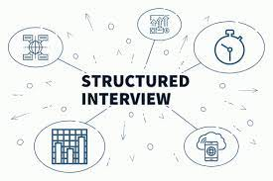
CONCEPTS
What Is a Structured Interview?
Notes:
A structured interview is one in which the interviewer has a standard set of questions to ask a job applicant — the same list that will be used for all candidates vying for the position.
James Durago, director of people operations at database platform company Molecula, told Built In in 2022 that he swears by the structured interview process. A tight labor market can make finding the right candidates for open positions particularly difficult. That’s why it’s even more important now to have well-thought-out plans for the interview process, Durago explained. By planning, hiring managers can tailor interviews to the roles they are hiring for and find the best candidates for them.
Structured interviews can be easier on interviewers, Durago said. It’s common for companies to have several different internal employees involved in the hiring process, and not all of them will have the same level of interviewing experience and preparation. Setting a well-defined interview structure helps make the experience better for candidates and ensures the costly hiring process is worthwhile for the company.
“You don’t just want to just throw it into the wind and hope and pray that it sticks. That’s not a good use of your money or your time.”
“Maybe you go through 10 candidates — that’s 10 hours of just your own personal time, and then you’ve got to ask other people to interview that person,” Durago said. “You don’t just want to just throw it into the wind and hope and pray that it sticks. That’s not a good use of your money or your time.”

Slide 9
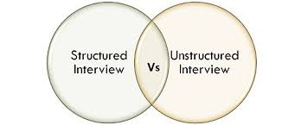
CONCEPTS
Structured Vs. Unstructured Interviews

Slide 10
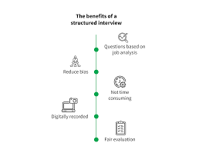
CONCEPTS
STRUCTURED INTERVIEW ADVANTAGES
Notes:
A structured interview provides the person asking the questions with a written checklist so they can get their bearings at the start of each interview and be sure they don’t miss anything important.
Having a predetermined structure can also give each interviewer a better understanding of their role and the purpose of the interview, which in turn can help them evaluate candidates. It gives them the ability to piece together a clearer picture of each applicant’s strengths and weaknesses.
Job interviews are already stressful for candidates, and having completely unstructured interviews can make the experience even more nerve-wracking. Giving candidates an outline of what to expect, like who they will speak to and what skills they will be tested for can take away much of the anxiety caused by uncertainty.
“For example, if I know this interview is going to be focusing on interpersonal skills or teamwork, then I can at least put myself in that frame of thought and put my best foot forward,” Durago said.

Slide 11
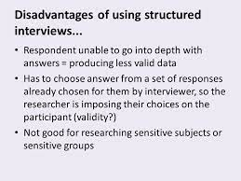
CONCEPTS
STRUCTURED INTERVIEW DISADVANTAGES
Notes:
The structured interview process also has its downsides. For example, the seemingly formal nature of ticking off questions has the potential to make an interviewer — and by association, their organization — come off as disconnected, cold or even intimidating. This can make it difficult to build a rapport or relationship with applicants, as well as get an accurate read on their temperament and communication skills.
And because a structured interview is supposed to stick mostly to a fixed set of questions, interviewers aren’t able to ask follow-ups that take more of a deep dive. They’re certainly able to prompt candidates to provide clarity or expand on something they said, but the structured interview process doesn’t necessarily allow them to stray into a more complex discussion.

Slide 12
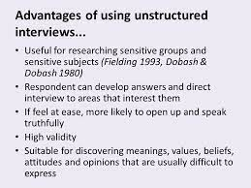
CONCEPTS
UNSTRUCTURED INTERVIEW ADVANTAGES
Notes:
Unstructured interviews can help interviewers evaluate a candidate’s approach to problem-solving and understand how they make decisions.
For Ani Khachatoorian, VP of people at e-commerce natural food company Thrive Market, that comes in handy when hiring for higher leadership positions. She’ll ask them standard questions about how many people they’ve managed and their department’s org chart, but also open-ended questions about their experiences and career journey.
“It’s not just the results — how you break down a complicated project is equally important,” she said. “Because we also want diversity of thought and diversity of experiences. And if we don’t ask for your experiences, and we just ask for that end result, we’re not going to have a team that could approach really big, hard problems in a multifaceted way.”
Even interviews for technical positions shouldn’t stick to a strictly structured format. Interviews for senior technical positions, especially, move away from curated coding questions and focus more on conversations about process and software design, said Sonali Moholkar, engineering manager at blockchain analysis company Chainalysis.
“When you have system design and behavioral rounds, they naturally tend to be a little more semi-structured,” Moholkar said. “Because there is no one way to design a system. Depending on the [candidate’s] experience, the conversations can go in completely different directions.”

Slide 13
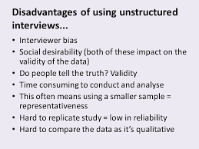
CONCEPTS
UNSTRUCTURED INTERVIEW DISADVANTAGES
Notes:
With a totally unstructured interview, there’s always the danger that an interviewer might try to fill up 60 minutes of time with random questions, or that different interviewers might ask one candidate the same questions.
As a candidate, Durago has been on the receiving side of poorly conducted unstructured interviews and has seen firsthand how disorganized they can be.
A sloppy interview process is not only a waste of the candidate’s time, but can also be harmful for the company in the long run. Job candidates are also consumers and can share their bad interview experiences with other consumers, which can have a negative effect on a company’s reputation.
“Those candidates, whether we hire them or not, have a platform, and that platform is powerful,” Durago said. “If you don’t have an [established] brand that can carry weight, then you’re making your job of growing your business exponentially harder.”

Slide 14
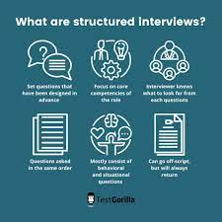
CONCEPTS
How to Conduct a Structured Interview
Notes:
All interviewers should be trained on basic interviewing skills, such as understanding what’s appropriate and relevant to ask during the interview process. If the hiring process consists of several interviews with different people, make sure they are not interviewing the candidates for redundant skills.
For structured interviews, Durago recommends writing down a list of interview questions and reviewing them with all interviewers before any candidates are involved.
Questions should be based on the company’s hiring philosophy and values, he said. Interviewers can reflect whatever is most important to the company by compiling questions that map back to those core values. Questions can then be tweaked for different positions in ways that still address those same values.
Hiring managers should also think about what types of employees thrive at the company, Durago said. All companies are different, with different corporate environments, so hiring managers should tailor interview questions to the types of candidates that would do well in their particular environment. If employees are expected to work on tight-knit teams, for example, the interview should include questions about their teamwork experience and communication skills. If employees are expected to be self-directed, interviewers should ask about their time-management strategies and methods for prioritizing tasks.
“If it’s a teamwork question, I can ask a software engineer, ‘Tell me about a time when you had a disagreement with one of your peers — how did you work it out?’” Durago said. “In sales, you can say something along the lines of, ‘Tell me about a time when you had a particularly challenging relationship with one of your existing clients — how were you able to salvage that relationship and turn it into a fruitful one?’”
It may also be helpful to let candidates know the overall structure of the interview process ahead of time. Companies shouldn’t share exact questions, but telling candidates how many sets of interviews there are, who they will talk to and the general types of questions to expect can help candidates prepare.
“Just letting them know that, for example, we use graphs a lot via the company so just be aware of traversing a graph,” Moholkar said. “It’s a huge domain to be aware of, because you don’t necessarily write algorithms on a day-to-day basis at work. So having the interviewers prep the candidates a little bit just helps.”

Slide 15

CONCEPTS
EXAMPLES OF STRUCTURED INTERVIEW QUESTIONS
Notes:
These 10 examples of structured interview questions can be tailored to cover assessing a candidate’s interpersonal and technical skills, whether they’d be a good fit for the team, how they approach solving internal and external challenges and their career trajectory.

Slide 16
CONCEPTS
What are your biggest strengths and weaknesses?
Describe how you give feedback to others and the most effective way for you to receive feedback.
Think about a really effective manager you worked under. What made them so successful in that position and did they demonstrate any skills or attributes you try to emulate?
What do you find most challenging about this kind of job? What skills, experience or knowledge do you bring that would help you overcome those challenges?
Tell me about a successful project you worked on. Why was it memorable to you and what was your role or contribution?
Notes:
One skill that makes you a desirable candidate for a job role is honesty. To show your honesty during the interview process, make sure that all the information you provide about yourself is correct. As most employers perform a background check on their new hires, there is no point in exaggerating about your experience, skills and qualifications.
For example, if you have mentioned in your resume that you are fluent in Spanish, be ready to demonstrate your skills in the interview. It is always advisable to write nothing but the truth on your resume. Being honest can help you gain the trust of the employer.

Slide 17
CONCEPTS
Tell me about a time when a project you worked on didn’t go as planned. What did you learn from that experience?
Tell me about a time when you disagreed with a colleague or manager. How did you communicate your difference of opinion and resolve the disagreement?
Tell me about a challenging relationship or interaction you had with a client. How did you work through that situation and turn the relationship or interaction into a fruitful one?
If you’re faced with (pose a common problem or task they’re likely to encounter in the job), briefly walk me through the steps you’d take to tackle that situation.
What are your career goals for the next five years and what experience or professional development opportunities do you think this company can provide to help you get there?

Slide 18

CONCEPTS
What are hypothetical interview questions?
Notes:
Hypothetical interview questions test your skill-level at identifying and addressing commonplace situations in the workplace. The quality of your responses gives the interviewer a glimpse of the way you think about problems that approach you, pre existing assumptions you have, the curiosity you exhibit when presented with the question and follow-up questions you may ask. In other words, navigating the questions can serve you well in comparison to the answer based on your willingness to solve the problem and display the right attitude in the process.

Slide 19

CONCEPTS
Can you tell me more about the day-to-day responsibilities of the role?
Notes:
Asking this question enables you to learn as much about the role as possible. The interviewer's response will provide insight into what skills and experience are needed, and will also help you decide if the role is right for you.
The answer will give you an idea of what the employer's expectations are, so if you're offered the job there should be no surprises when you start.

Slide 20

CONCEPTS
How could I impress you in the first three months?
Notes:
This is a good question to ask at the end of a job interview because it shows potential employers that you're eager to make a positive contribution to the organisation.
Pay close attention to the recruiter's response as it will tell you how they want you to perform and will highlight particular areas of the job you should be focusing on during the first few weeks of employment.

Slide 21

CONCEPTS
Are there opportunities for training and progression within the role/company?
Notes:
Enquiring about development opportunities demonstrates to the interviewer that you're serious about your career and committed to a future with the organisation.
You don't want to be stuck in a dead-end job so if you're unsure of the typical career path for someone in this role, asking this question will help you to assess whether a long-term career with the company is a possibility, or if you'd need to move on to gain further responsibility.

Slide 22

CONCEPTS
Where do you think the company is headed in the next five years?
Notes:
The response you receive will give you an insight into the company's progression plans and its place in the market, while giving you a general idea about job security. You may also get a heads-up on any major upcoming projects.
Asking about future plans shows a real interest in the organisation and reiterates your commitment to the company.

Slide 23

CONCEPTS
Can you describe the working culture of the organisation?
Notes:
Asking this question is a great way to assess the working environment of the company and it gives you the opportunity to discover whether you'll fit in.
From the recruiters response you'll learn if and how the organisation prioritises employee happiness, of any benefits on offer and what the work-life balance is like.

Slide 24

CONCEPTS
What do you enjoy about your job?
Notes:
Everybody loves to talk about themselves and this question enables you to build up a sense of camaraderie with your interviewer. This question requires a personal response, so you could learn a lot from their answer.
You'll get an insider's view of the company culture and working environment and you may even get to discover how your interviewer got their start in the business and how they progressed.

Slide 25

CONCEPTS
Can you tell me more about the team I would be working in?
Notes:
This will help you understand the way the company is structured, who you'll report to and the department the role sits within. These are the people you'll work most closely with, so it's worth trying to find out about the team dynamic and working methods.
Depending on the response, it may also give you the opportunity to mention any experience or success you've had working in similar teams - just to give the employer one final example of how well you'll fit in if you get the job

Slide 26
CONCEPTS
Other useful questions to ask at interview include those about:
performance appraisals
opportunities or challenges facing the department/company
company-specific projects or campaigns.
Notes:
If the employer doesn't give an indication of what happens next then a good way to wrap up the interview is by asking about the next steps and when you can expect to hear from them.

Slide 27




THANK YOU
+91 78150 95095
codemithra@ethnus.com
www.codemithra.com

